Slide 1
Support Vector Machines

Slide 2
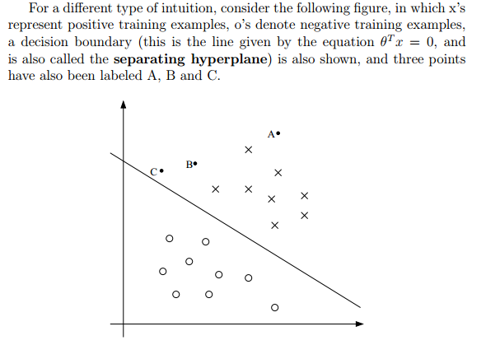


Slide 3
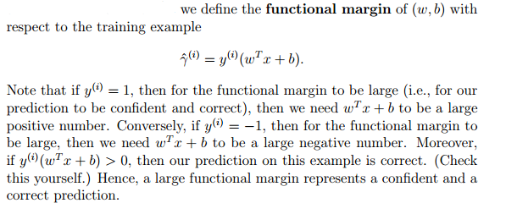
Functional and geometric margins
By exploiting our freedom to scale w and b, we can make the functional margin arbitrarily large without really changing anything meaningful.

Slide 4


Slide 5
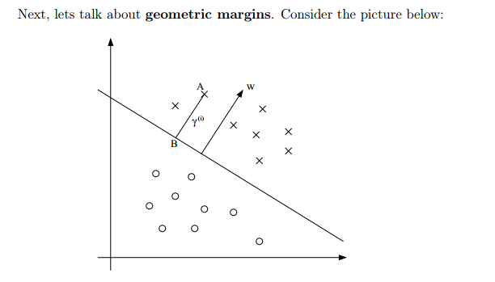


Slide 6



Slide 7



The optimal margin classifier

Slide 8
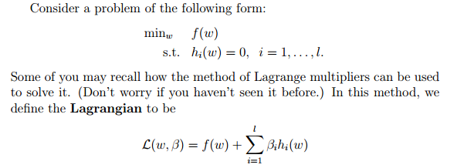

Lagrange duality

Slide 9
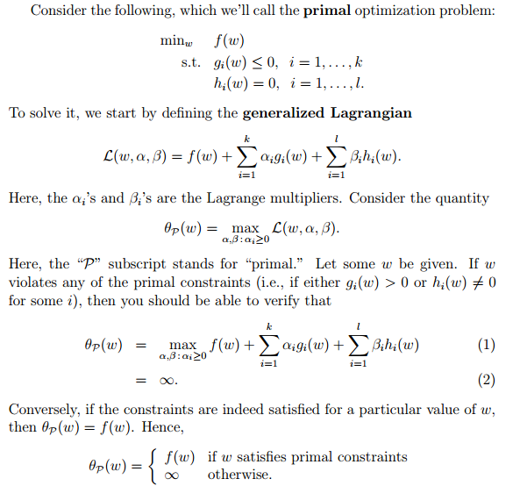

Slide 10


Slide 11

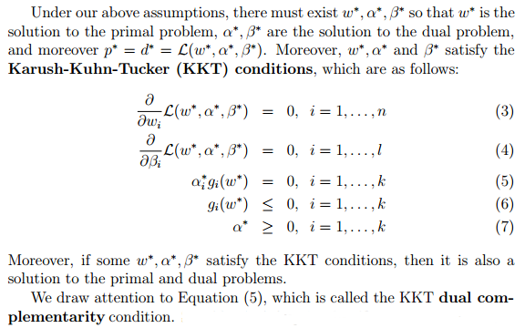

Slide 12
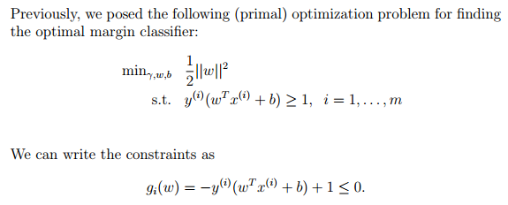

Optimal margin classifiers

Slide 13
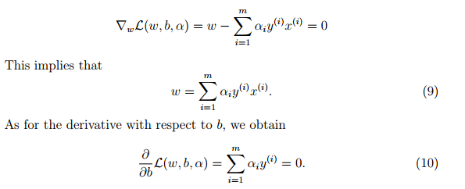


Slide 14





Slide 15



Slide 16
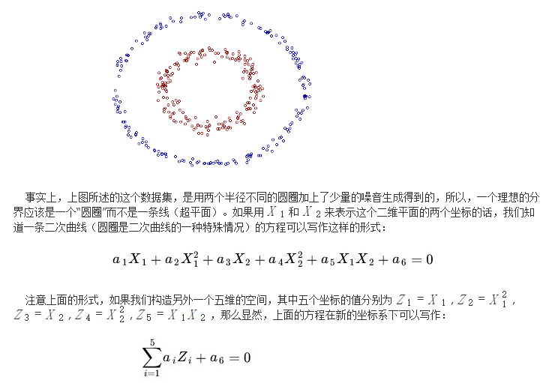
Kernels

Slide 17
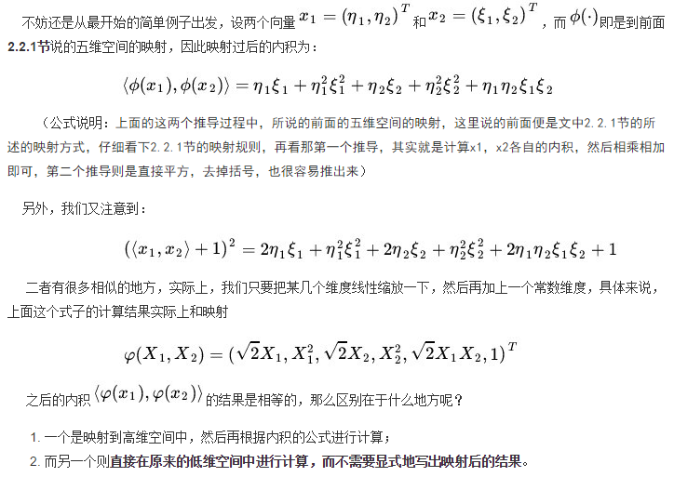

Slide 18


Slide 19
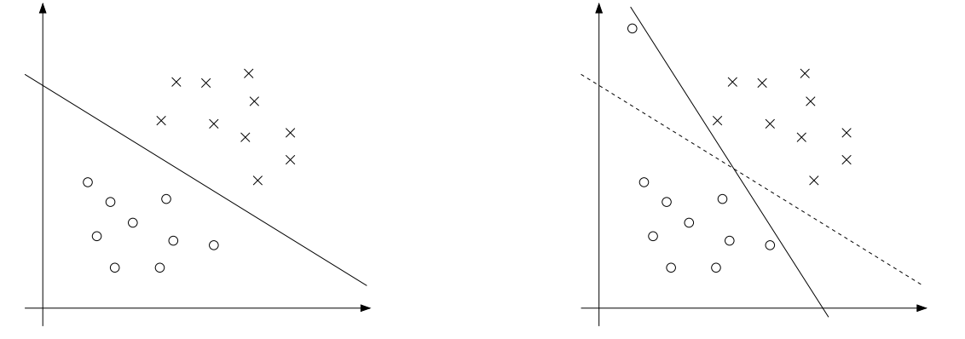
Regularization and the non-separable case

Slide 20



Slide 21



Slide 22
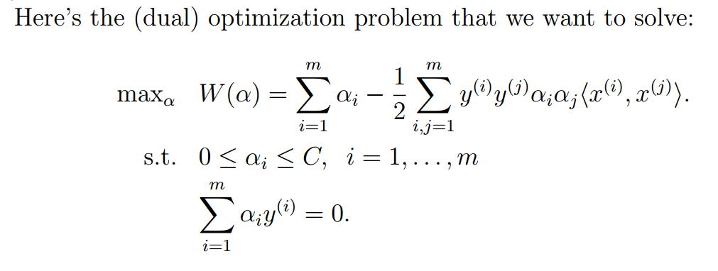

The SMO algorithm

Slide 23


Slide 24
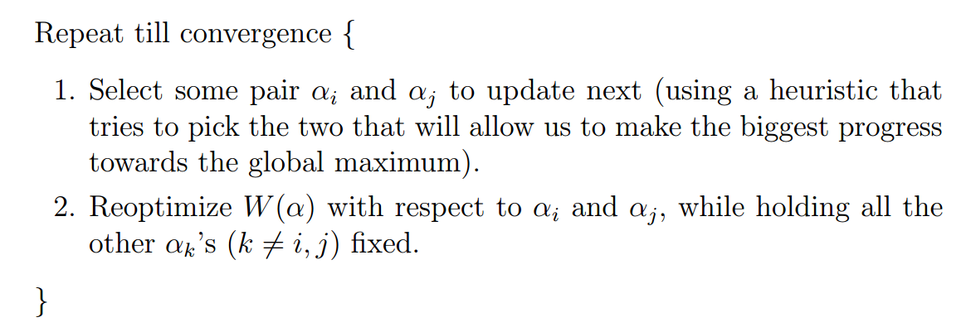

Slide 25
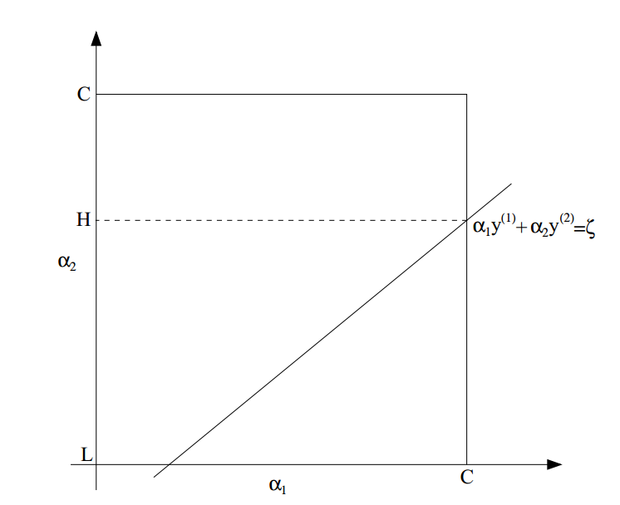

Slide 26
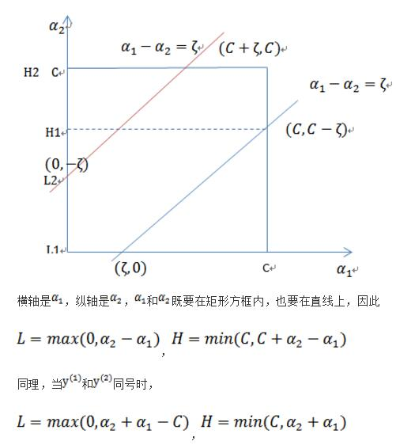


Slide 27
